Slide 1
R-LADIES GLOBAL
library(dplyr)
rladies_global %>%
filter(city == 'ALL')

Slide 2
What is R-Ladies?
#rdogladies

Slide 3
Worldwide organization that promotes diversity in the #rstats community via meetups and mentorship in a friendly and safe environment

Slide 4

Our mission
more women coders
more women developers
more women speakers
more women leaders
more women developing and creating R Packages and being involved in the R community

Slide 5
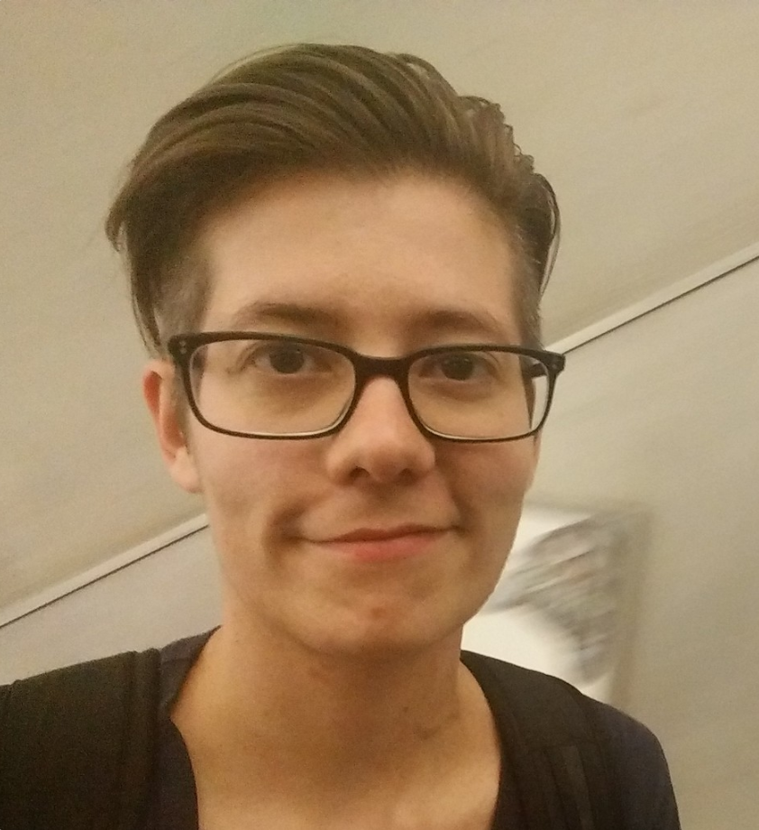
Who we are
The Leadership Team
Alice Daish
Claudia vitolo
Hannah frick
erin ledeLL
Gabriela de Queiroz
London
San Francisco

Slide 6
When R-Ladies was born?
#rchickenladies

Slide 7
San Francisco, CA
October 2012

Slide 8
2013
Taipei
(Taiwan)
San
Francisco
London
(UK)
Twin Cities (USA)
2012
2016
2013
R-Ladies was born

Slide 9
June 2016 - useR!
San Francisco and London meet and get together to create …

Slide 10
#rdogladies
The R-Ladies Global! (Aug 2016)

Slide 11
What happened since then?

Slide 12
R-Ladies Growth
20+ COUNTRIES
6000+ MEMBERS
45+ CITIES

Slide 13
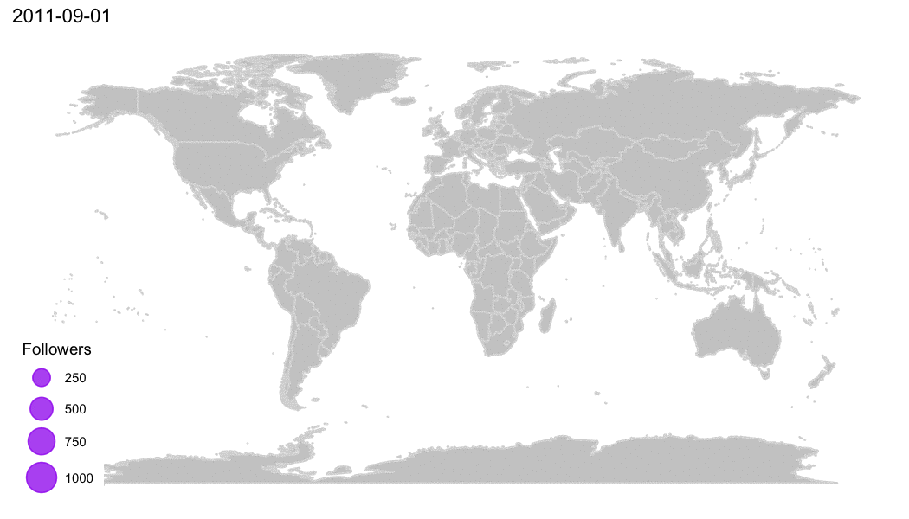
Twitter followers by each chapter
Made with 💜 by Daniela Vázquez

Slide 14
R-Ladies Community

Slide 15
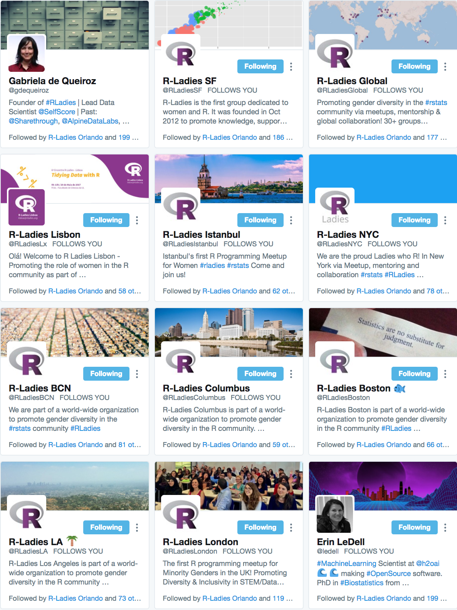
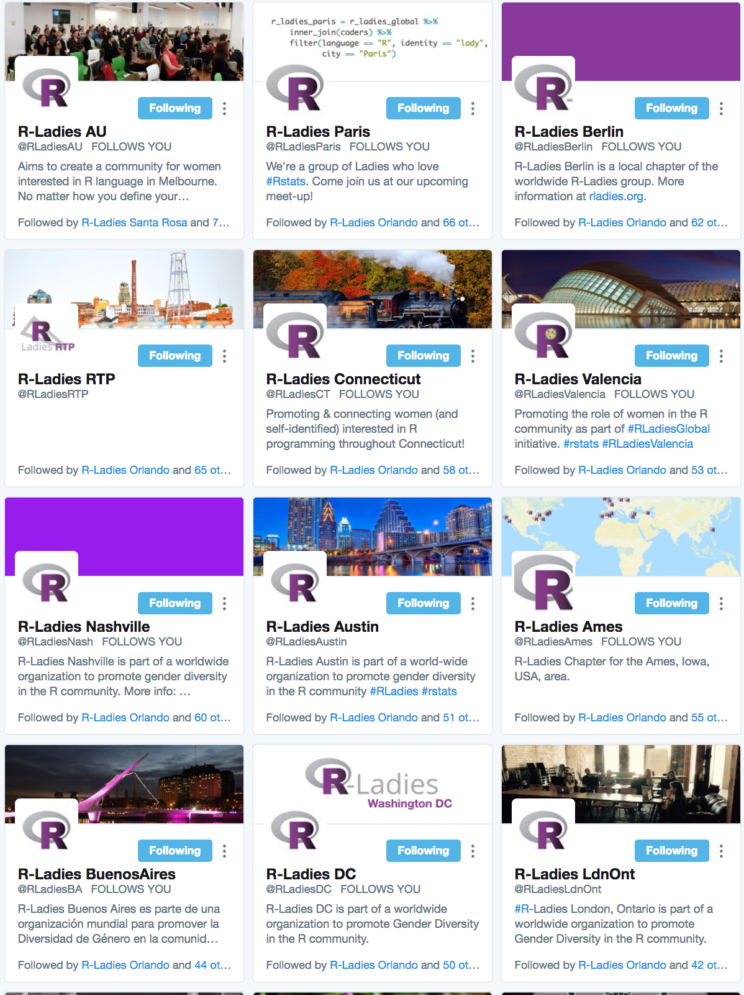
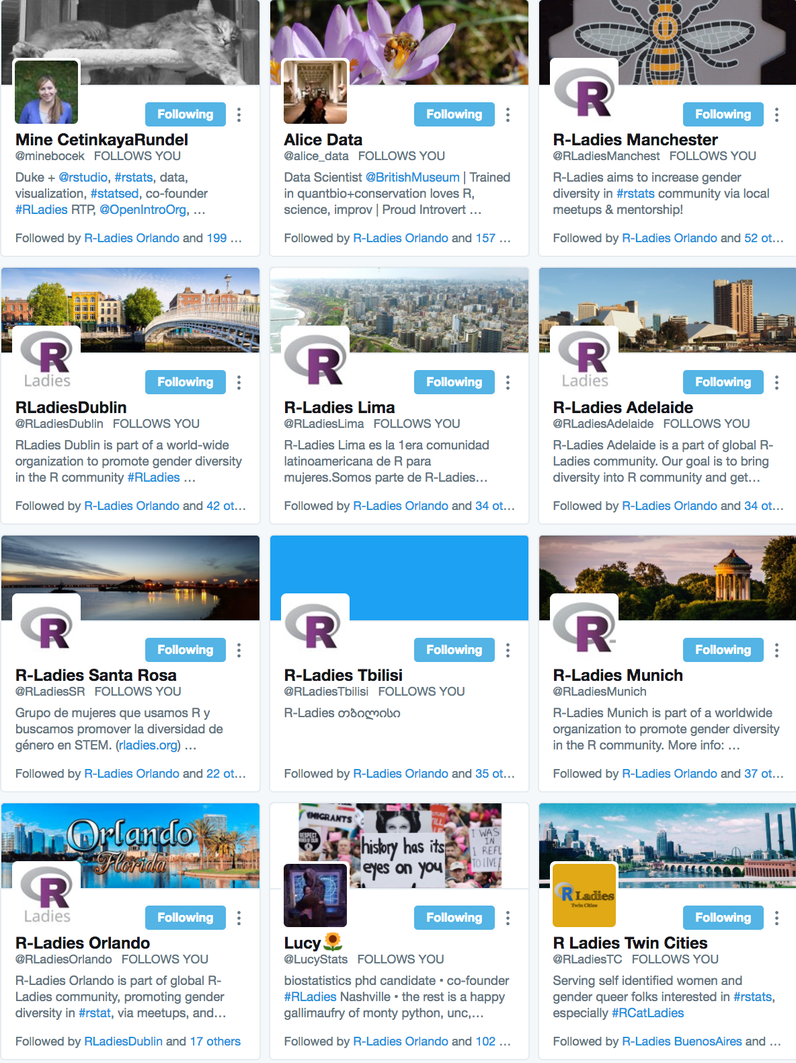
#RLadies Twitter
http://bit.ly/rladies_twitter

Slide 16
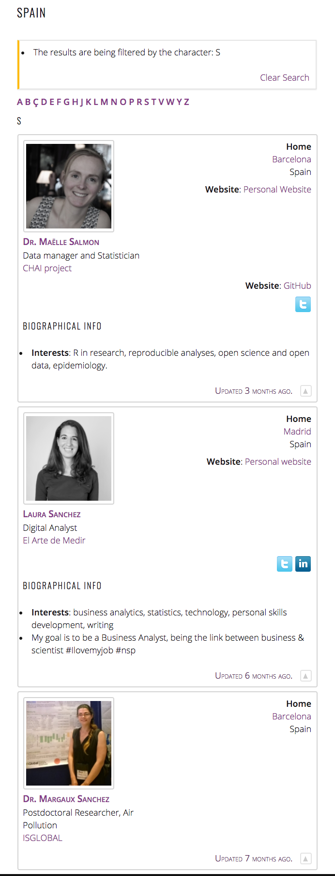
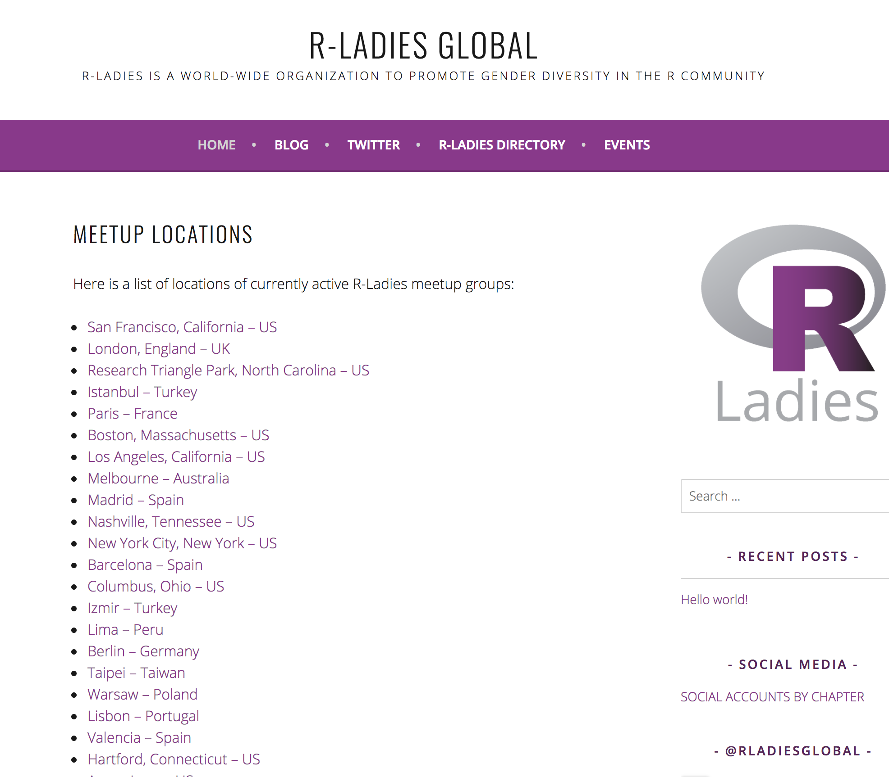
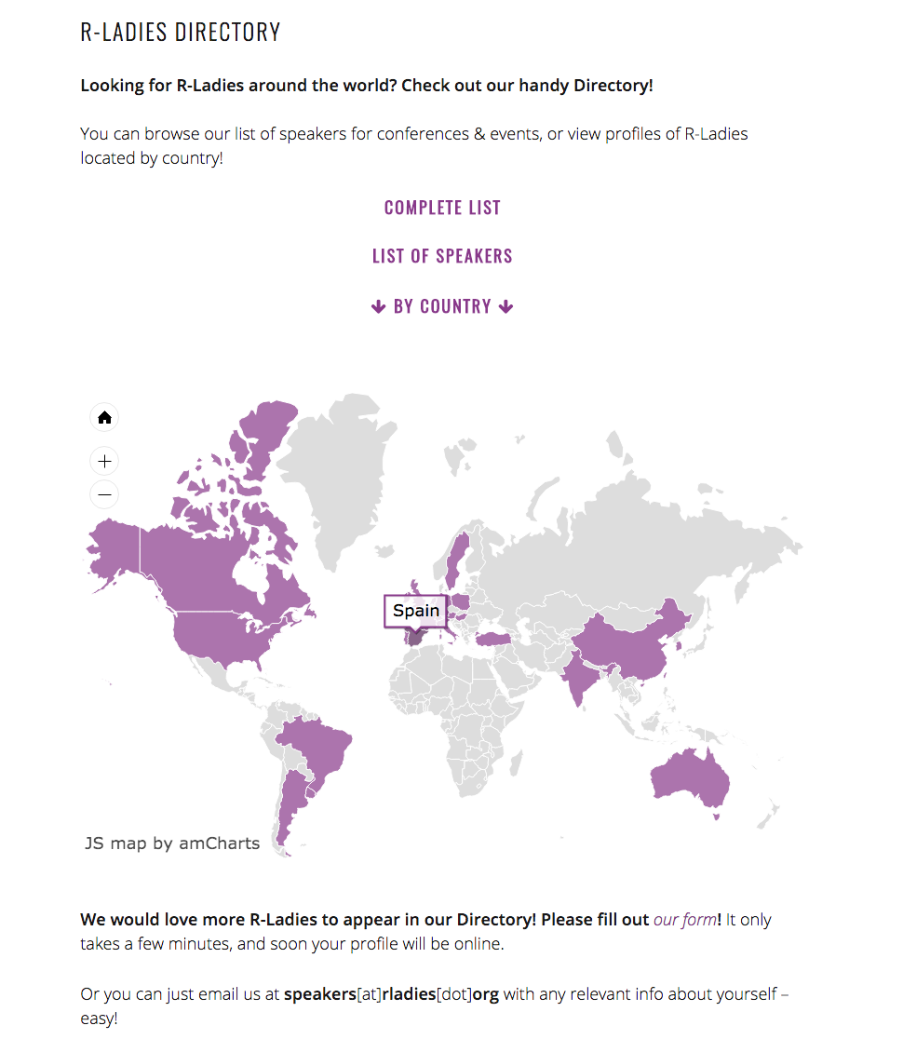
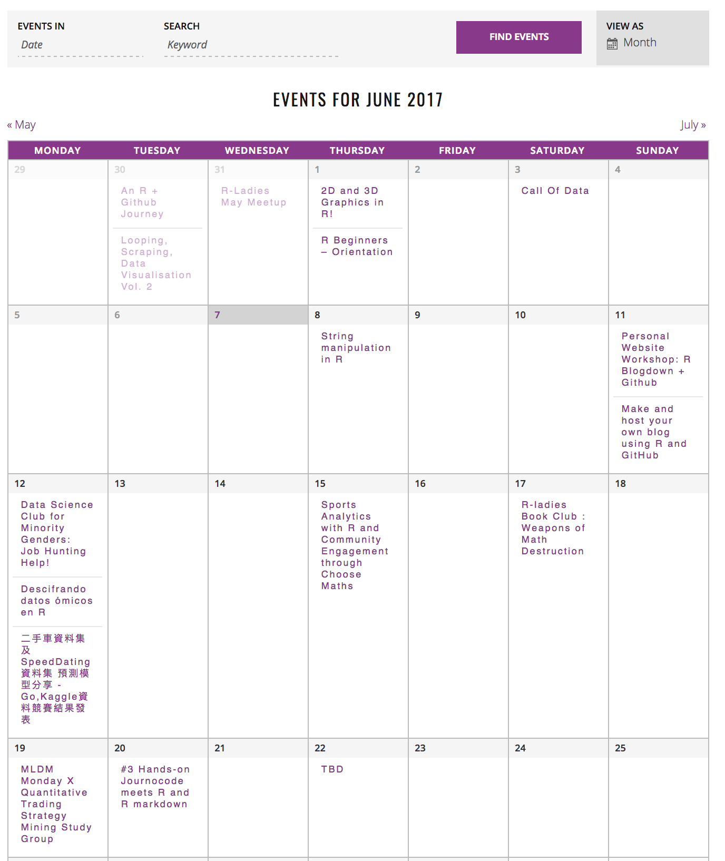
R-Ladies Website
R-Ladies Speakers
All R-Ladies events
Made with 💜 by Bea Hernández

Slide 17
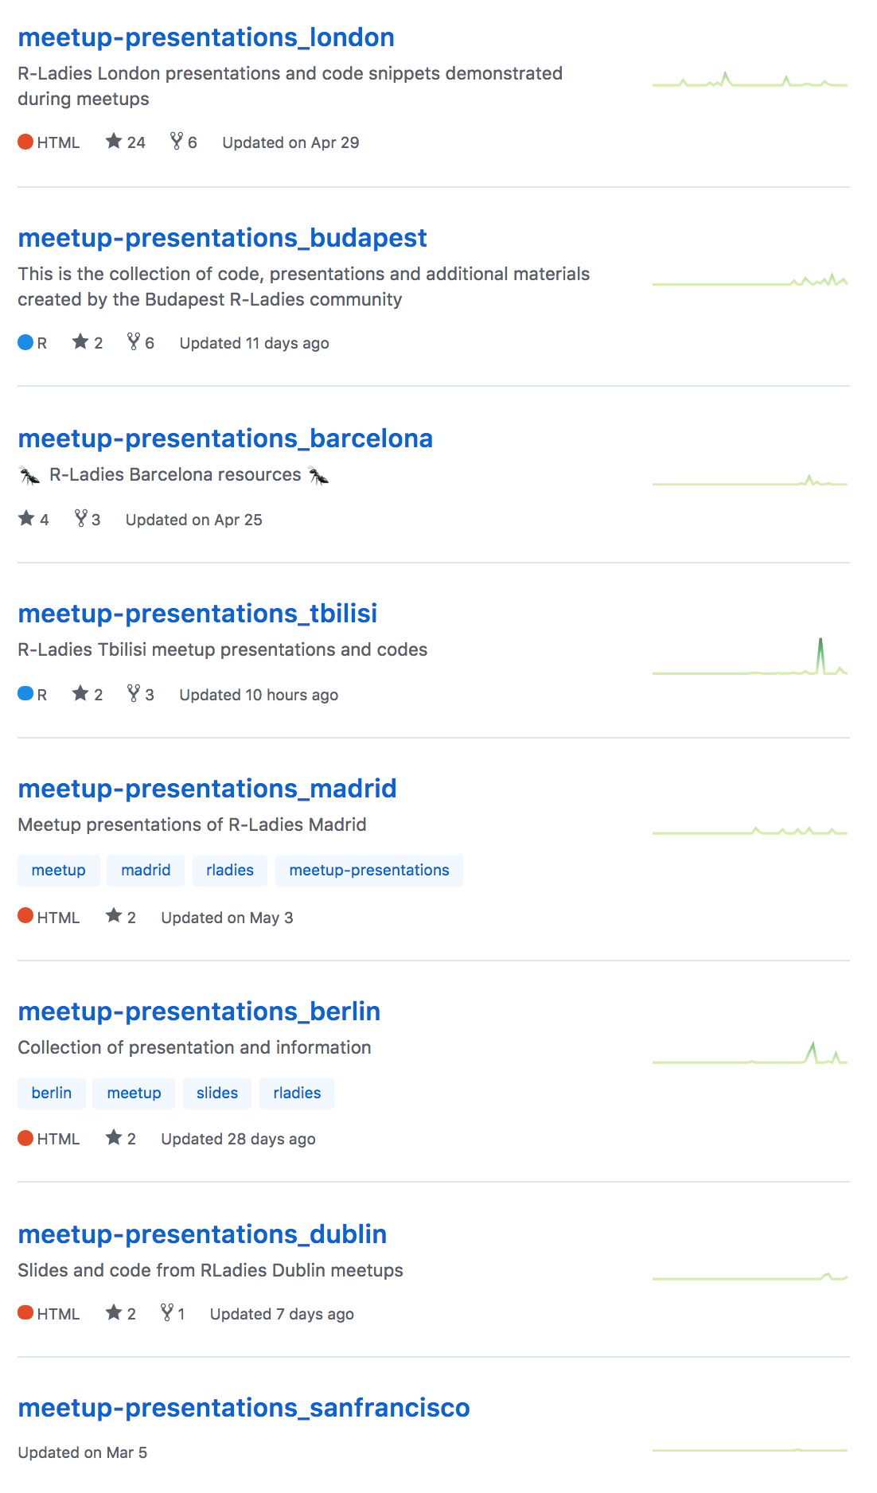
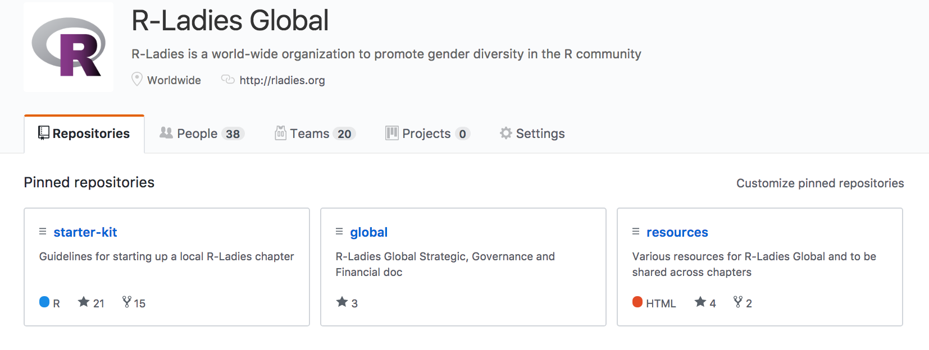
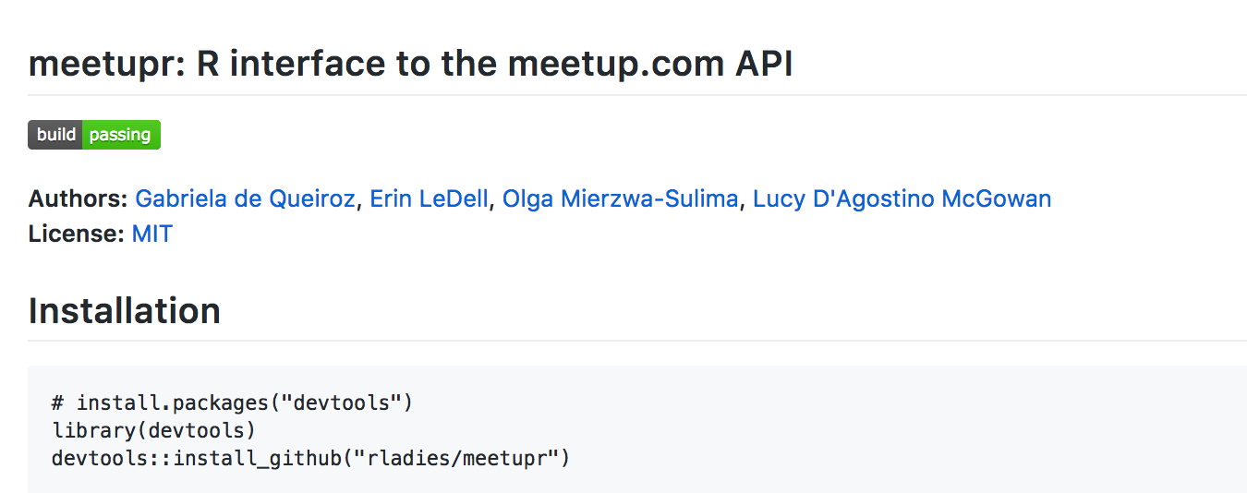
R-Ladies Github
R-package
Shared Material

Slide 18
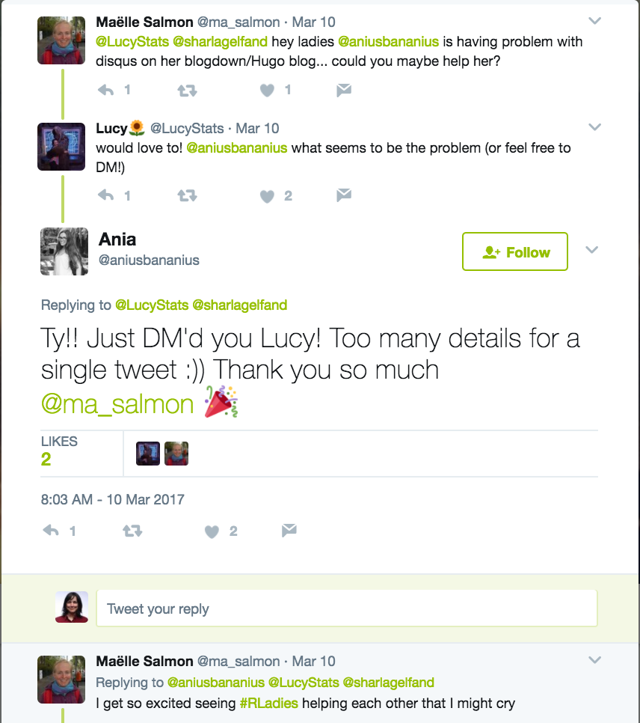
R-Ladies Support

Slide 19
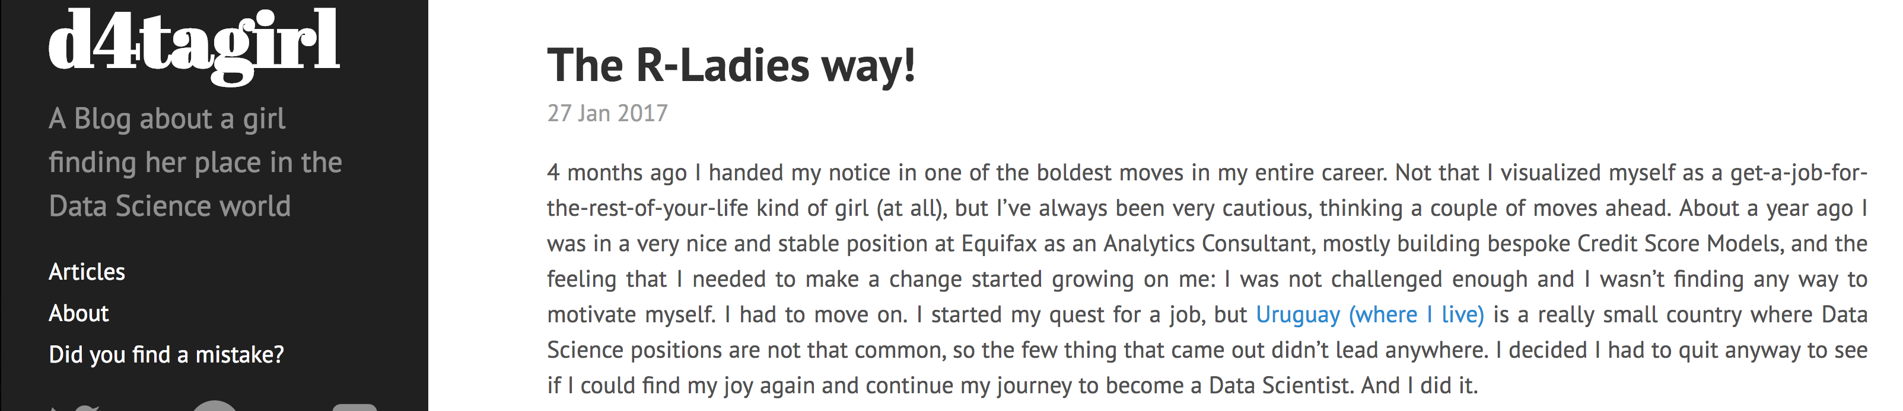
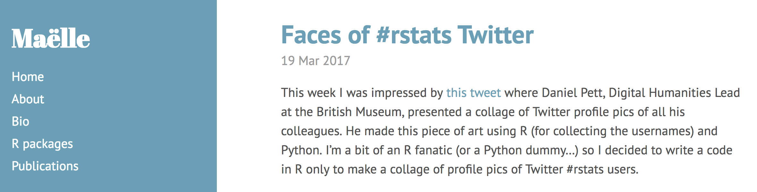
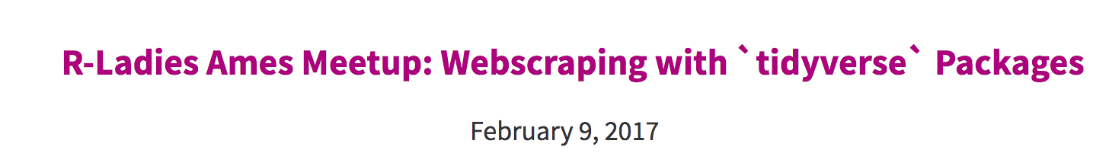
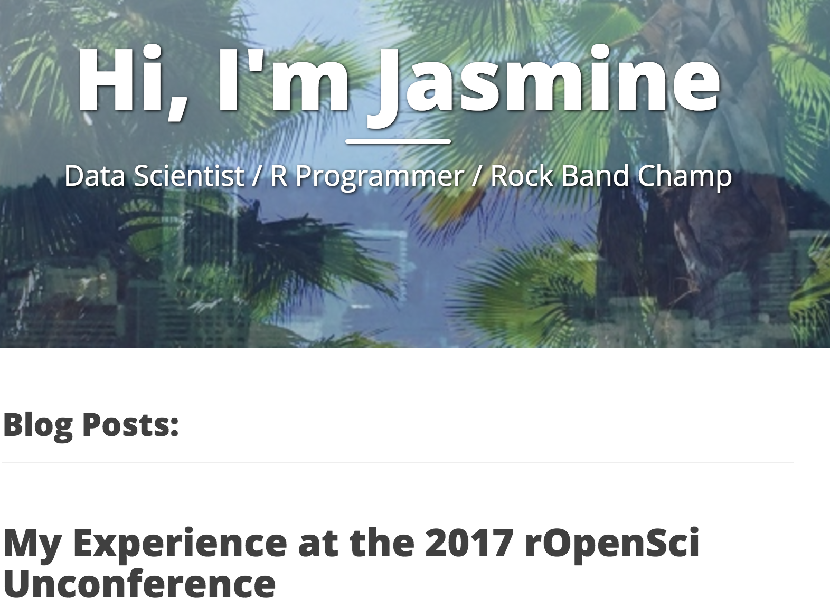
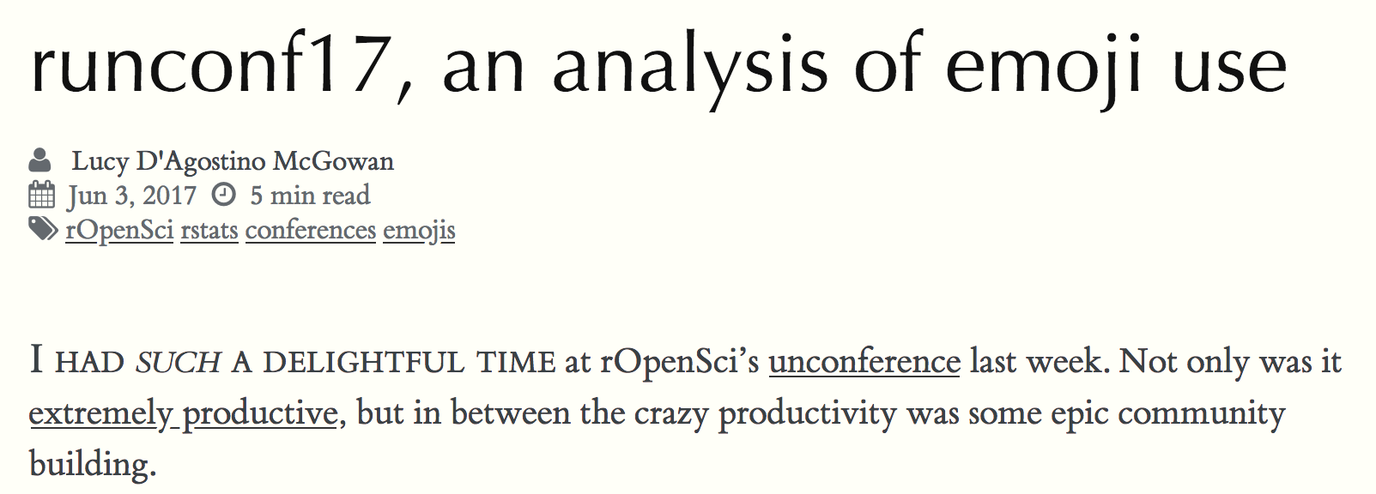
R-Ladies Blogs
http://www.masalmon.eu/
https://d4tagirl.com/
https://sctyner.github.io/
https://jasdumas.github.io/
http://livefreeordichotomize.com/

Slide 20
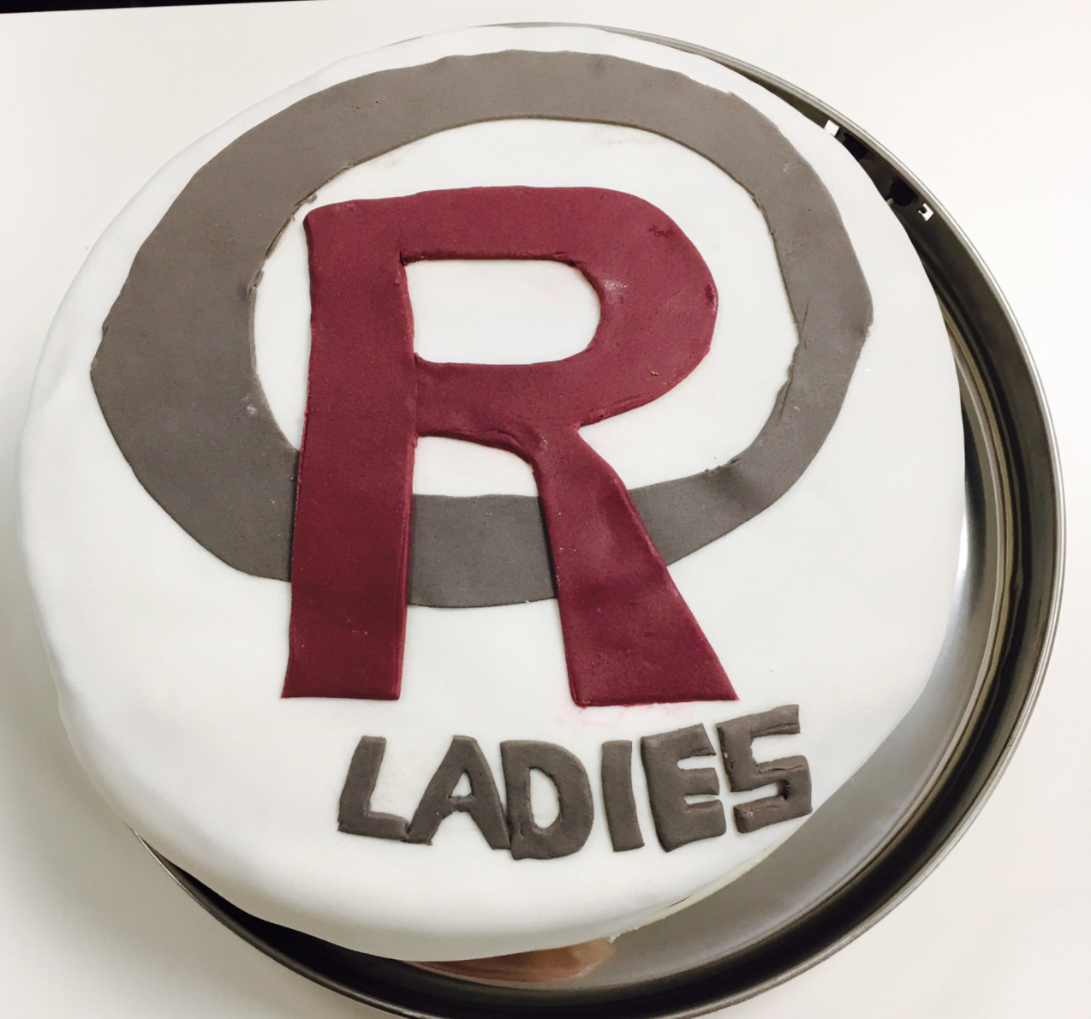
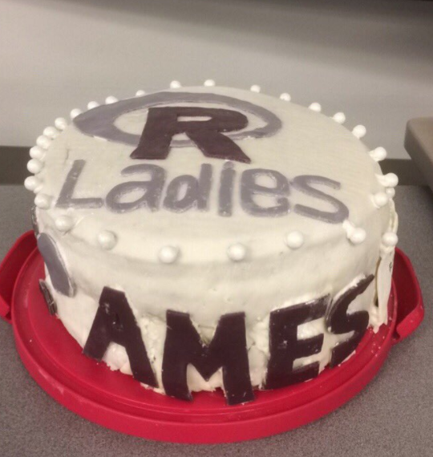
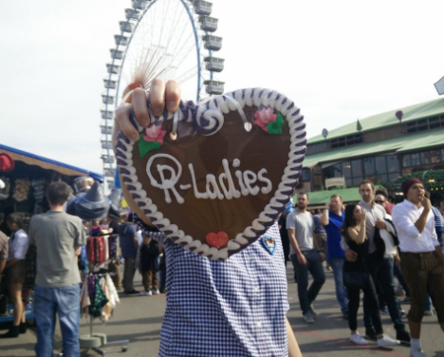
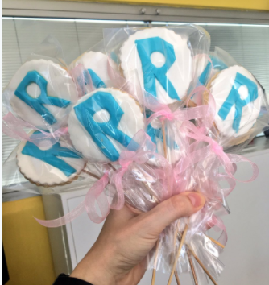
R-Ladies Food

Slide 21
R-Ladies Visits
R-Ladies Lisbon
R-Ladies Rio de Janeiro
Mia Chang from R-Ladies Taipei
Gabriela de Queiroz from R-Ladies San Francisco

Slide 22
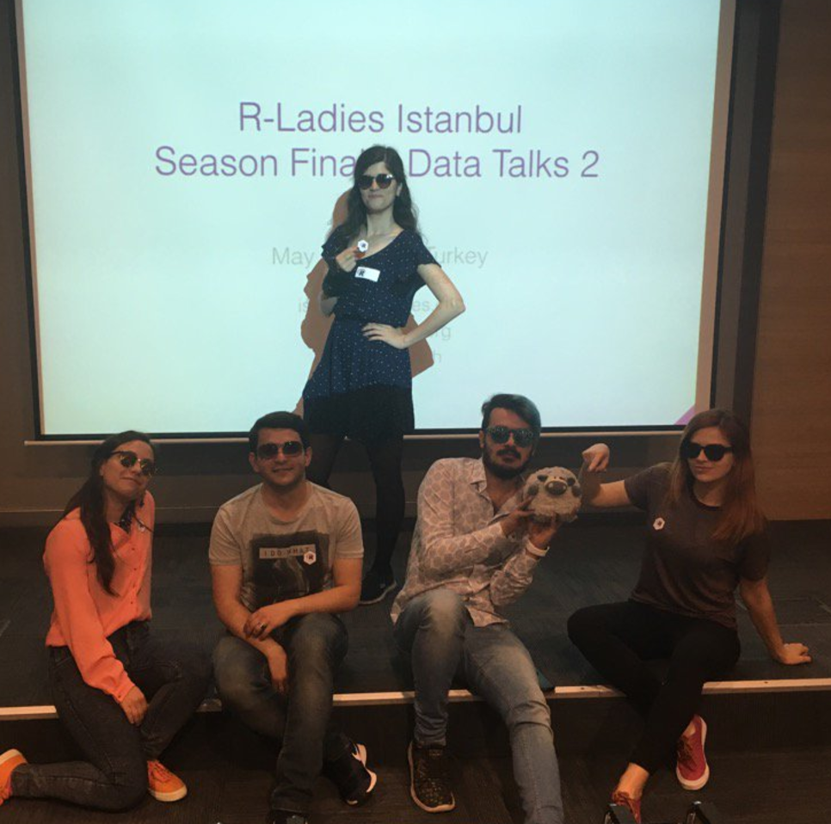
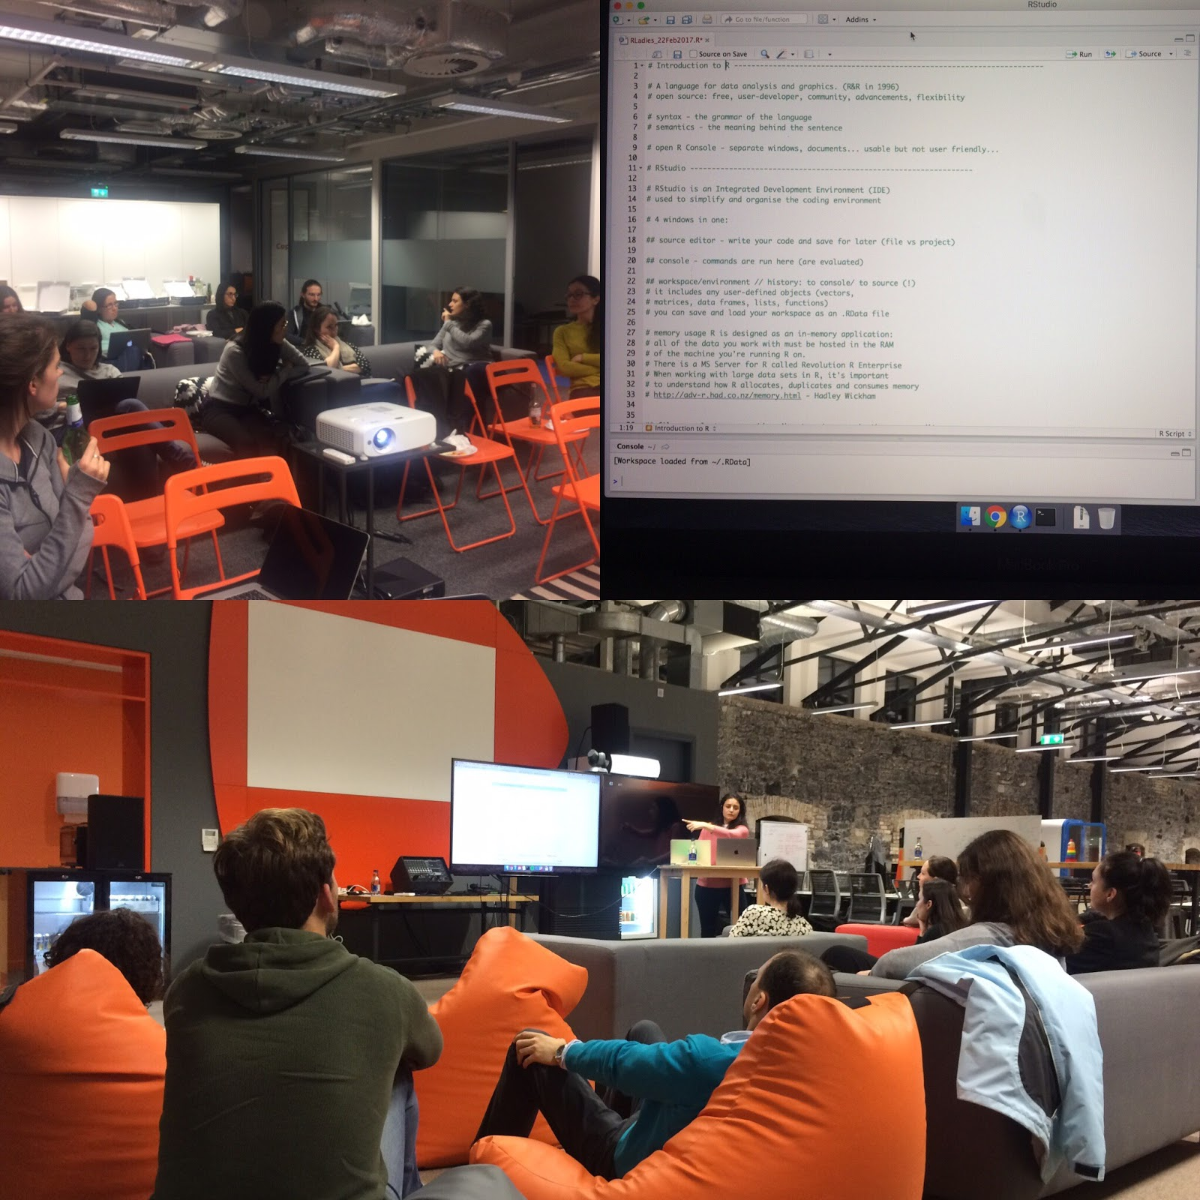
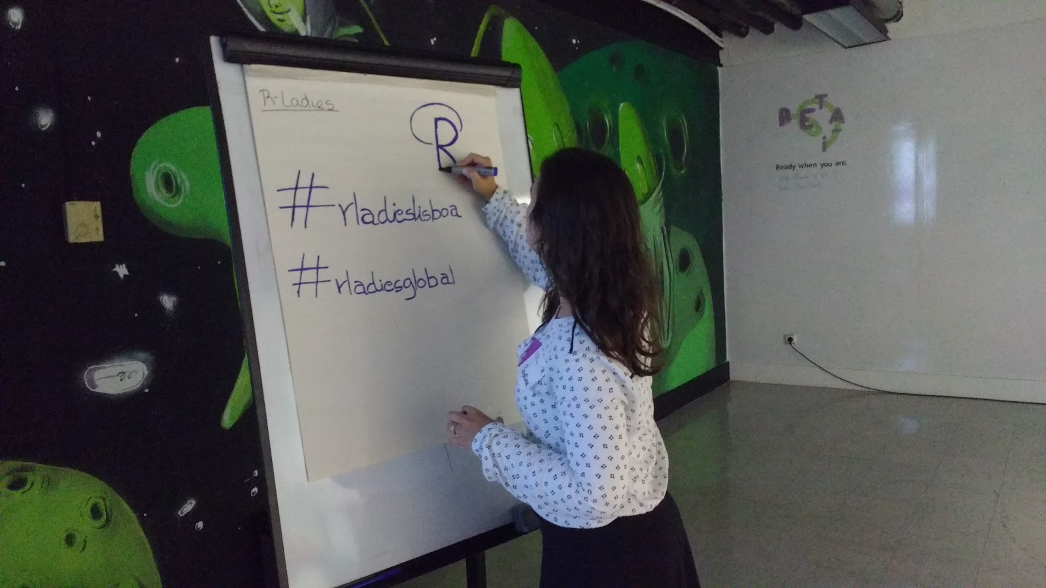
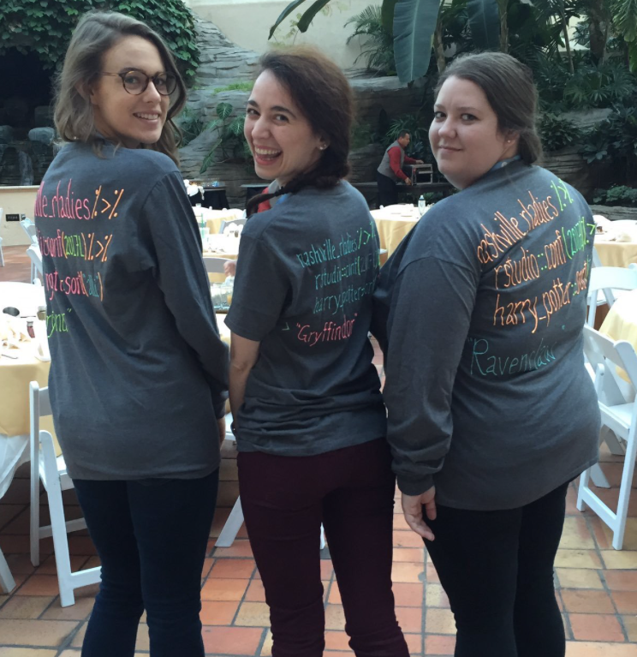
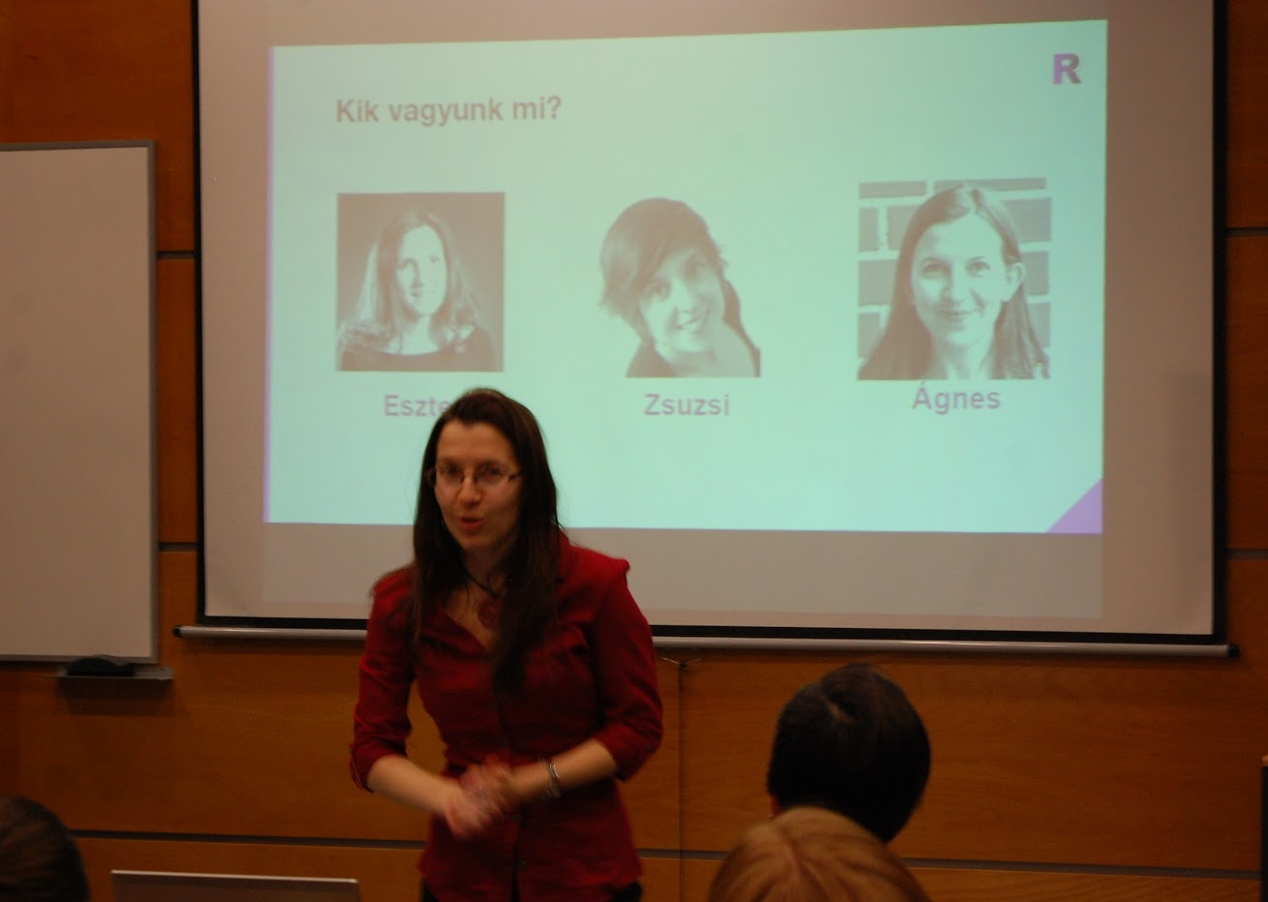
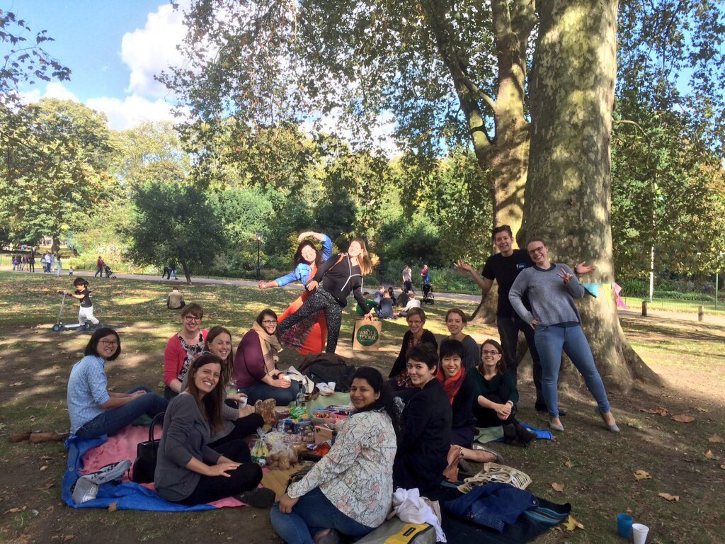
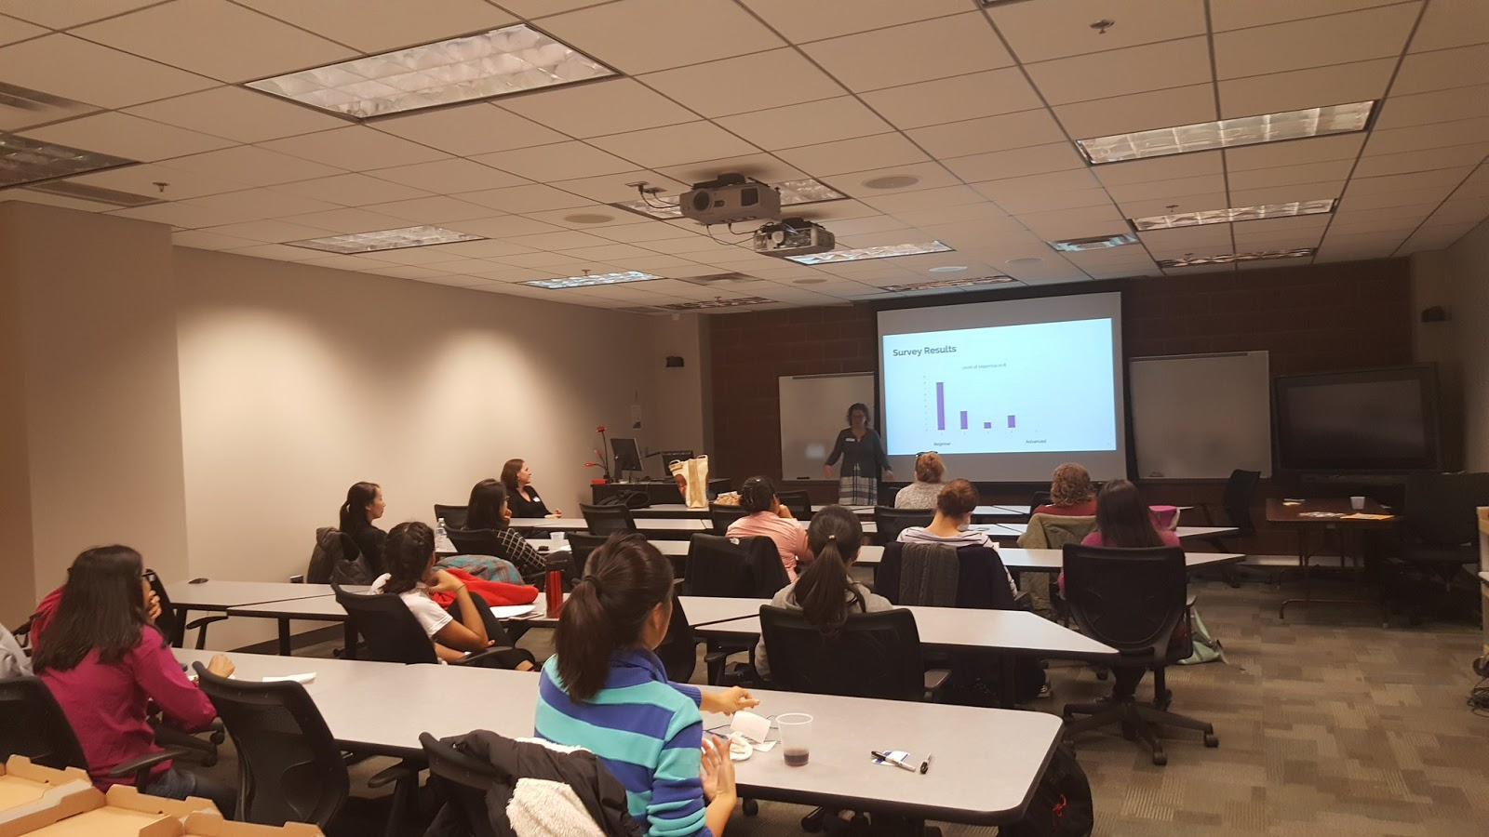
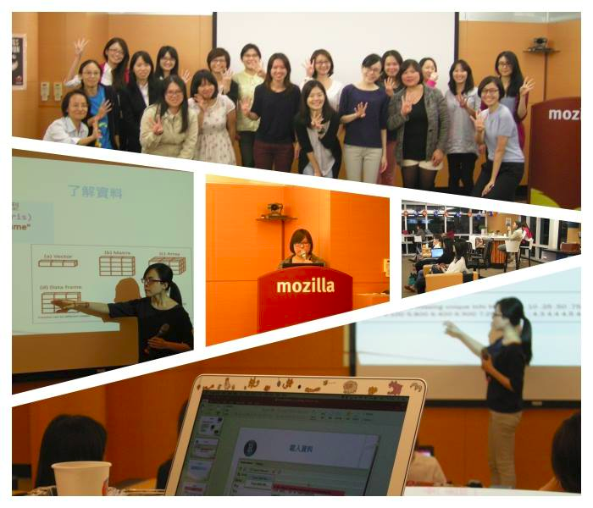
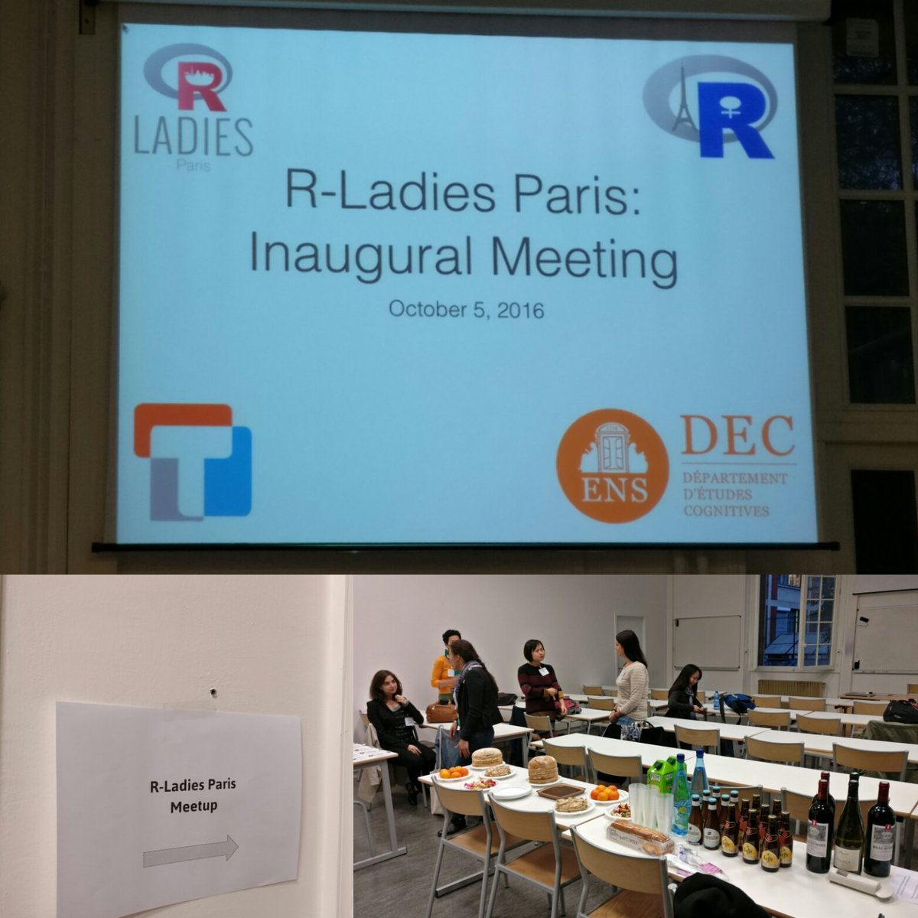
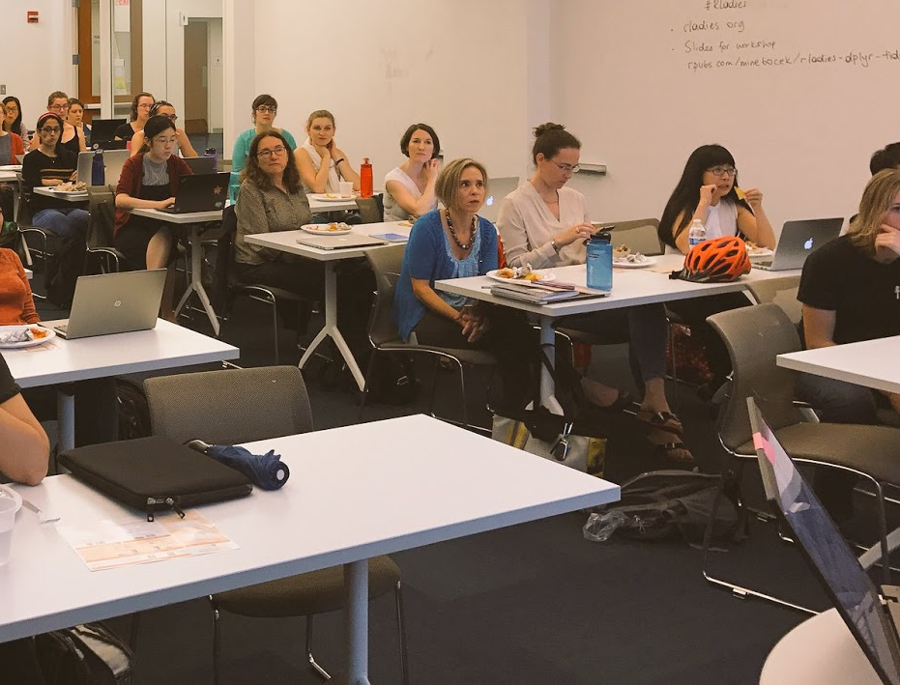
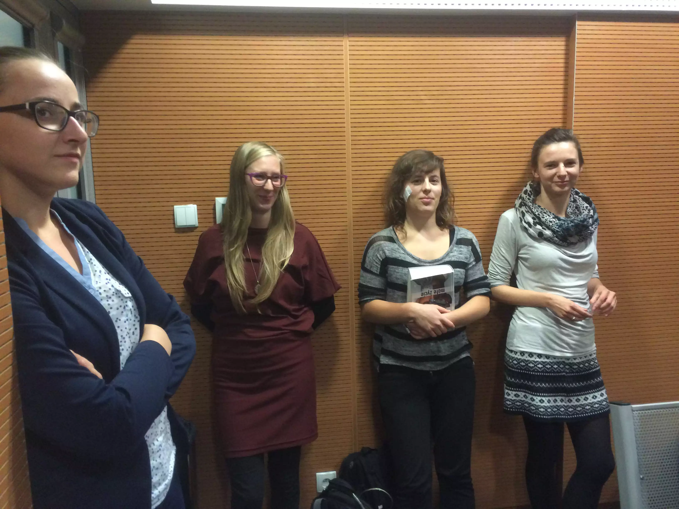
R-Ladies Events

Slide 23
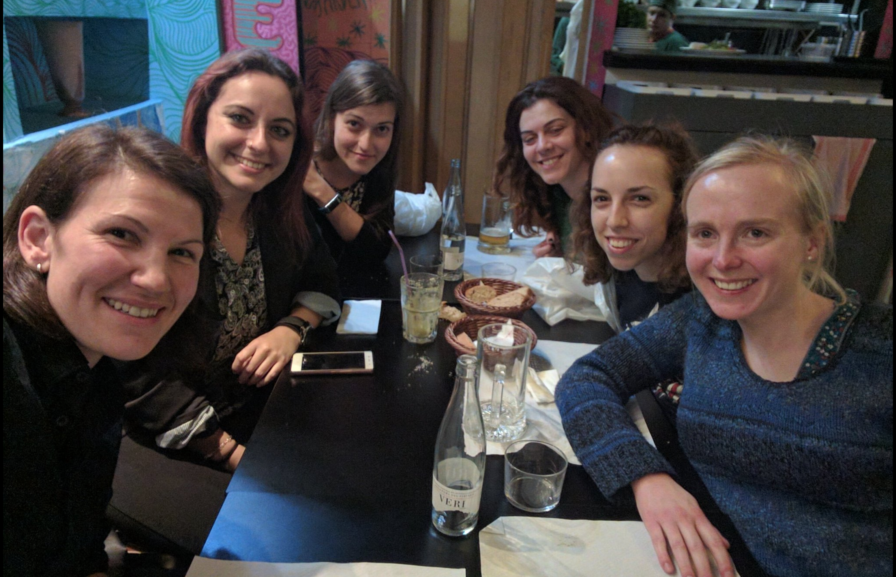
R-Ladies Tour
Erin LeDell - Europe Tour
Daniela Vázquez - US Tour
R-Ladies SF
R-Ladies BCN
R-Ladies NYC
R-Ladies London

Slide 24
R-Ladies Go Beyond
R-Ladies Taipei got together with @pyladies and @GirlsinTech, to teach the Taiwan president how to code!

Slide 25

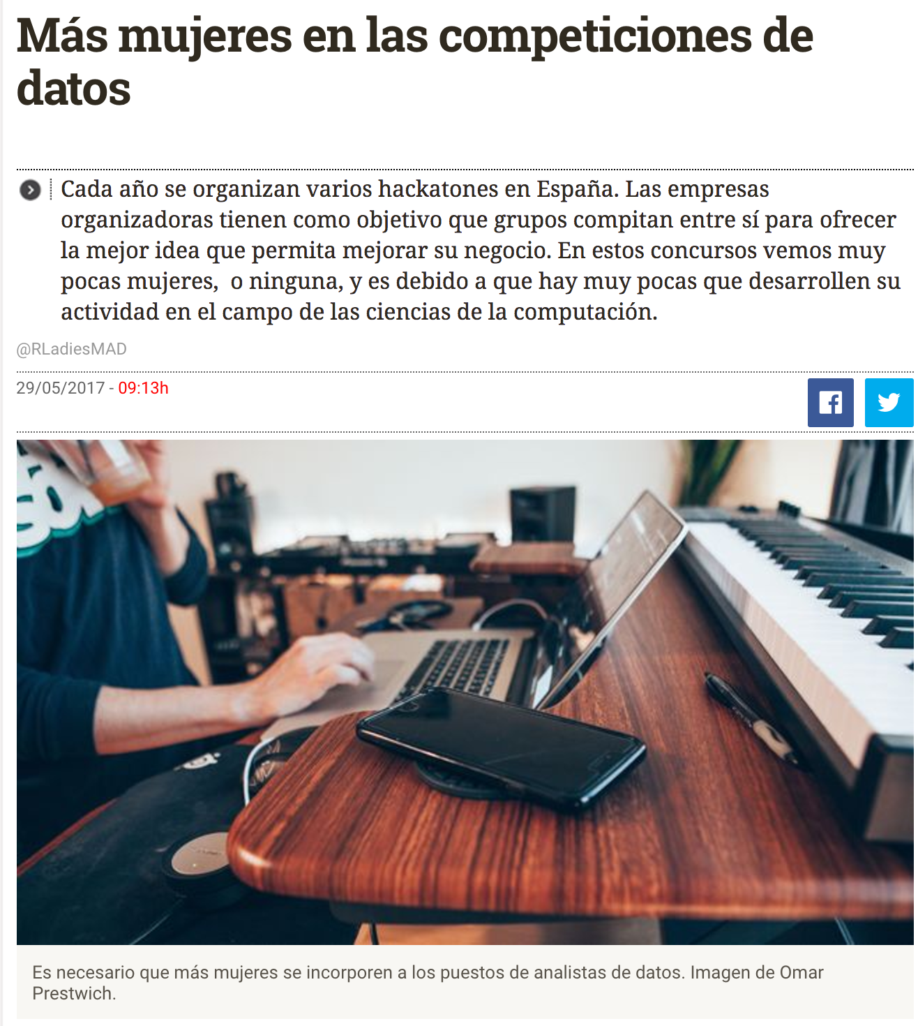
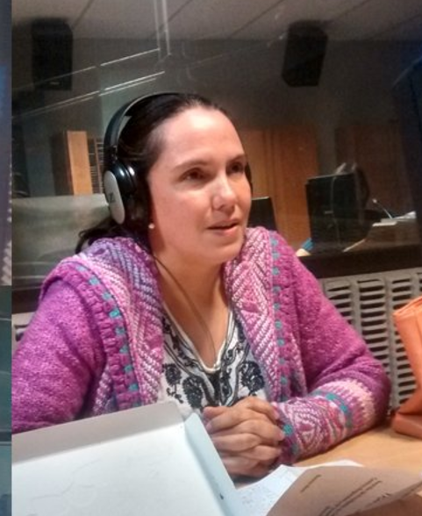
R-Ladies in the Media
Alice Daish from R-Ladies London
R-Ladies Madrid
Yanina Bellini from R-Ladies Santa Rosa

Slide 26
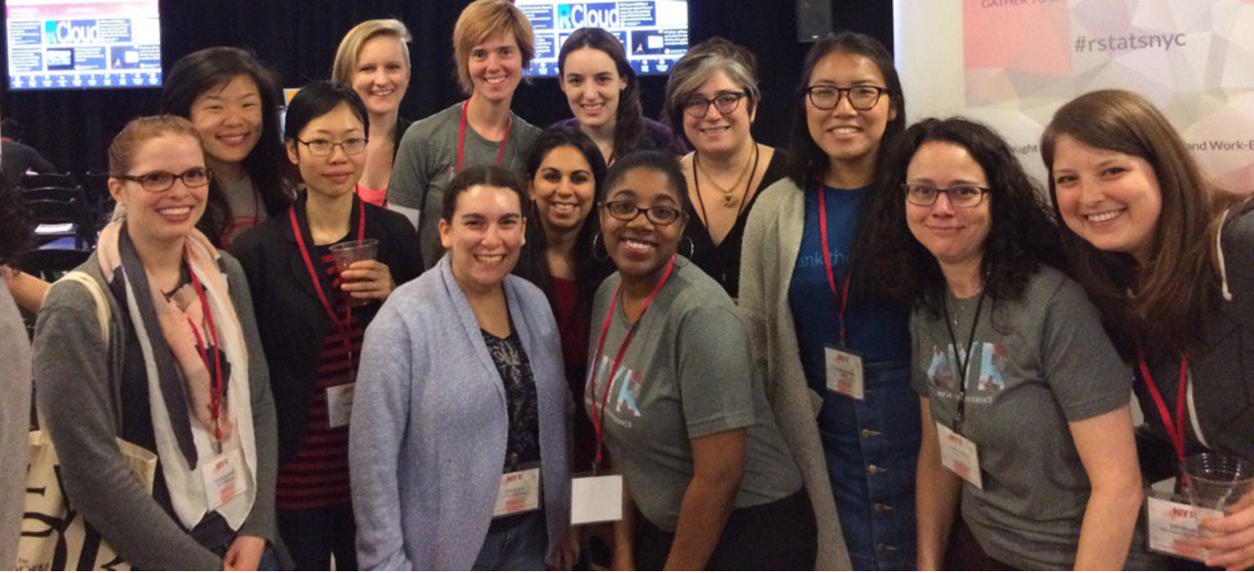
R-Ladies Unite
New York R Conf
OpenSci RUnconference
ENAR

Slide 27
What is going on in the SF Chapter?

Slide 28
R-Ladies SF
Organizers
Gabriela de Queiroz
Erin LEDELL
Ciera Martinez

Slide 29
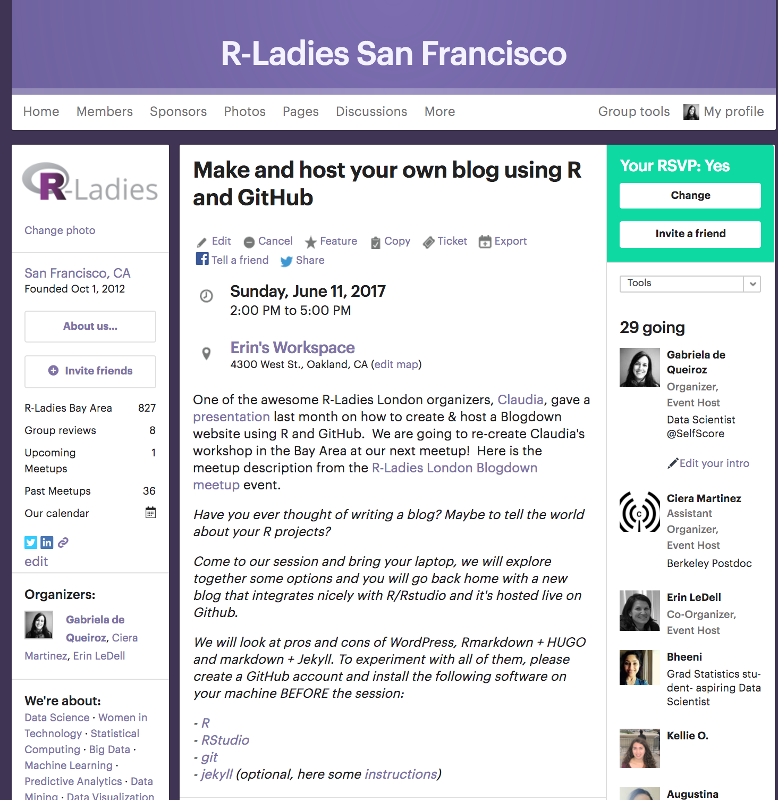
Next Meetup
Sunday, June 11
sf@rladies.org

Slide 30
How can I start my own chapter?
#rcatladies

Slide 31

Send an email to
info@rladies.org

Slide 32
We’ll send everything you'll need!
#rdogladies

Slide 33
COME JOIN US!

Slide 34
THANK YOU!
Website: rladies.org
Twitter: @RLadiesGlobal
Email: info@rladies.org

